Slide 1
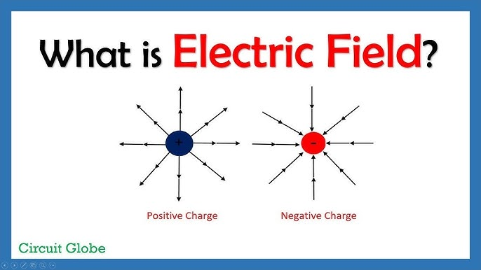
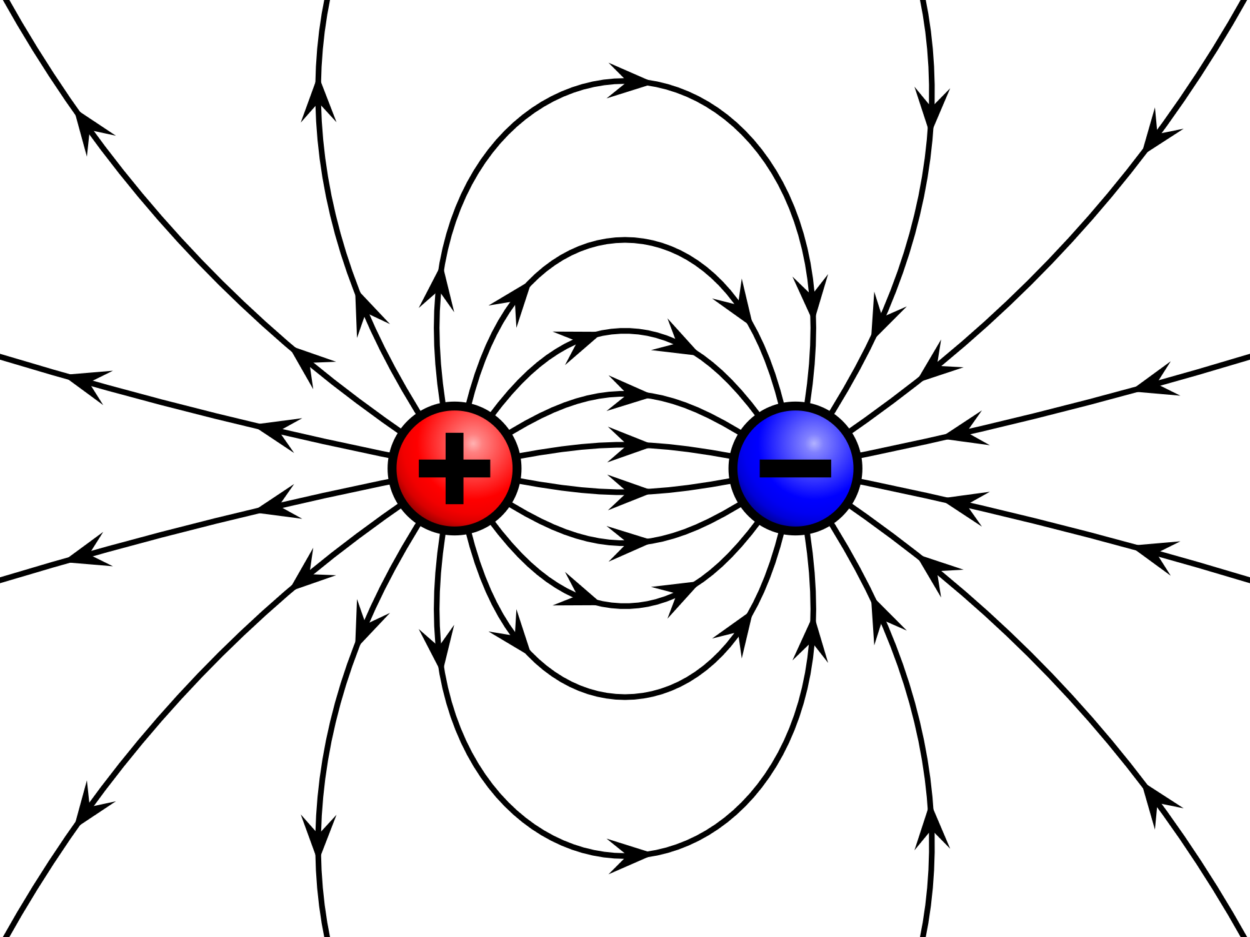
Introduction:
The electric field is a fundamental concept in electromagnetism that describes the influence exerted by a charged particle on other charges within its vicinity. This field is responsible for the interaction between charged objects, affecting the forces they experience. Understanding electric fields is crucial in various technological applications, from everyday electronics to complex machinery. The concept not only underpins basic physics but also plays a pivotal role in shaping modern devices. Electric fields are essential in devices such as photocopiers and capacitive touchscreens, making them vital in the development of modern electronic systems.
Importance of the Topic:
Electric fields are key in many technologies that we use daily. They enable the function of devices that range from printers to smartphones. By understanding how electric fields work in these contexts, we can improve and innovate on existing technologies, making them more efficient and versatile.

Slide 2

Concept of Electric Field
An electric field is created by charged particles (either positive or negative) and is responsible for the force experienced by other charges placed within this field. The electric field (E) at a point is defined as the force per unit charge:
E=F/q​
Where F is the force experienced by a test charge q. The electric field is a vector field, meaning it has both magnitude and direction. The direction of the electric field points away from positive charges and toward negative charges. The field's strength depends on the magnitude of the charge and the distance from the charge, following Coulomb’s law:
E $=\frac{k . |Q|}{r^{2}}$
Where k is Coulomb's constant, Q is the source charge, and r is the distance from the charge.
Applications of Electric Fields:
Capacitors:
Electric fields are crucial in capacitors, where they store energy by creating a potential difference between two conductive plates separated by an insulating material.
Electronics:
In devices like transistors and diodes, electric fields control the flow of current.
Sensors:
Electric fields are used in various sensors, such as touchscreens, where they detect changes in capacitance.
Medical Equipment:
Electric fields are used in medical imaging and treatments, such as in electrocardiograms (ECGs) and defibrillators.
Understanding electric fields allows scientists and engineers to design and improve countless technologies, from electronic circuits to renewable energy systems.

Slide 3

Photocopiers
Photocopiers utilize electric fields in the process of electrophotography, where an image is transferred onto paper using charges and electric fields. The process can be broken down as follows:
Charging the Photoconductive Drum: A photoconductive drum is uniformly charged by a corona wire that creates a high voltage, establishing an electric field over the drum's surface.
Exposure to Light: The document to be copied is scanned, and areas of the drum exposed to light lose their charge, while the dark areas retain the charge due to the electric field.
Toner Attraction: A negatively charged toner is then applied to the drum. The toner particles are attracted to the positively charged regions, while the unexposed areas remain toner-free.
Transfer to Paper: The toner on the drum is transferred to paper using the electric field, where it sticks due to the electrostatic forces, and then fused by heat to create a copy.
This process demonstrates how electric fields are used to manipulate charged particles for image transfer and copying.

Slide 4
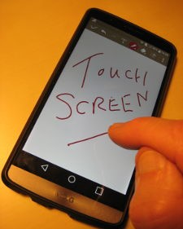
Capacitive Touchscreens
Capacitive touchscreens use electric fields to detect touch input. These screens rely on the conductive properties of the human body to alter the electric field. The process works as follows:
Electric Field Creation: A capacitive touchscreen consists of a layer of conductive material, typically indium tin oxide, which is transparent and forms a grid of electrodes. These electrodes create a uniform electric field across the screen.
Touch Interaction: When a finger touches the screen, it introduces a disturbance in the electric field. Since the human body is conductive, it alters the capacitance at the point of contact.
Capacitance Detection: The touchscreen detects the change in capacitance and identifies the exact location of the touch based on the disturbance in the electric field.
Response: This information is sent to the device’s controller, which interprets the user’s input.
This application is fundamental in smartphones, tablets, and other touch-sensitive devices, where the electric field is key to detecting user interaction.

Slide 5
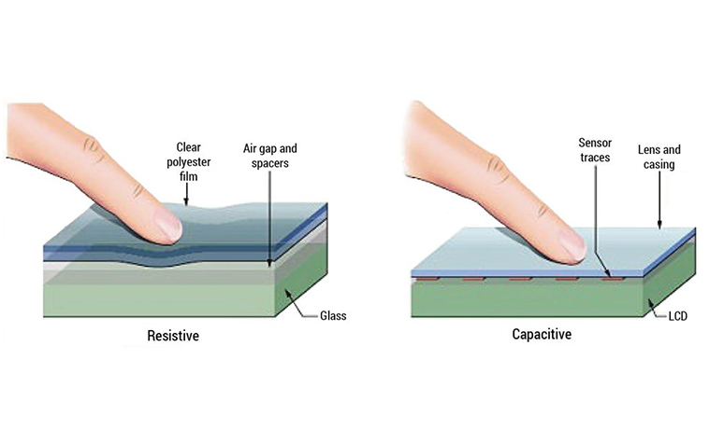

Slide 6

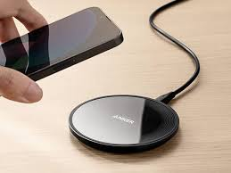
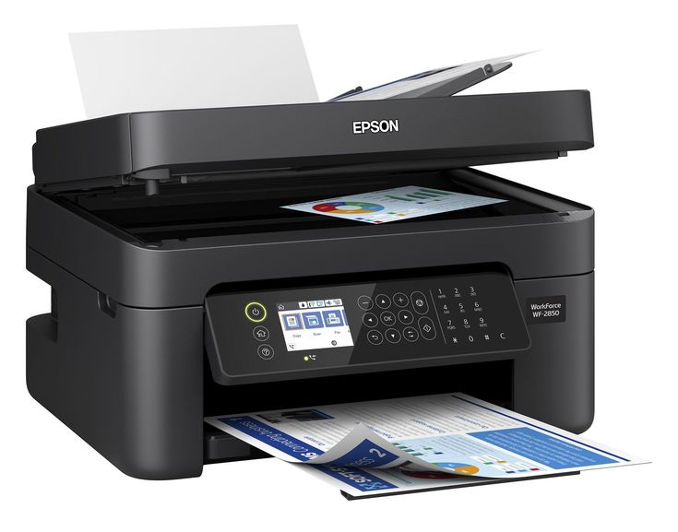

Real-Life Examples
Here are a few real life examples of where electric field is responsibe for
Lightning
Inkjet Printers
Laser Printers
Electric fencing
Dust attraction to TV screens
Wireless charging pads for smartphones and laptops
Liquid Crystal Displays (LCDs) in monitors and TVs

Slide 7
Conclusion:
Electric fields are fundamental to various technological applications, including photocopiers and capacitive touchscreens.
In photocopiers, electric fields are used to transfer toner particles onto paper, while capacitive touchscreens use electric fields to detect user input by measuring changes in capacitance.
These applications are critical in everyday devices such as printers and smartphones, demonstrating the importance of electric fields in modern technology. The understanding of electric fields not only helps in improving existing technologies but also opens the door for innovations in fields like electronics, communication, and computing.
References:
Griffiths, D. J. (2017). Introduction to Electrodynamics (4th ed.). Pearson Education.
"Capacitive Touchscreen Technology," TechRadar. Retrieved from https://www.techradar.com.
"How Photocopiers Work," HowStuffWorks. Retrieved from https://electronics.howstuffworks.com/photocopier.htm.

